Slide 1
THE SCIENCE OF SIN AND SALVATION
ROBERT MELASHENKO MD
Copyright Robert Melashenko 2013
All Rights Reserved

Slide 2
LECTURE FIVE
IN THE GARDEN

Slide 3
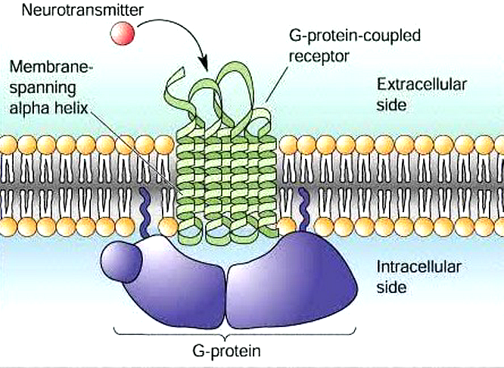
REVIEW

Slide 4
G protein-coupled receptors are found only in eukaryotes, including yeast, and animals. The ligands that bind and activate these receptors include light-sensitive compounds, odors, pheromones, hormones, and neurotransmitters, and vary in size from small molecules to peptides to large proteins. G protein-coupled receptors are involved in many diseases, and are also the target of approximately 40% of all modern medicinal drugs. (From Wikipedia web page)

Slide 5
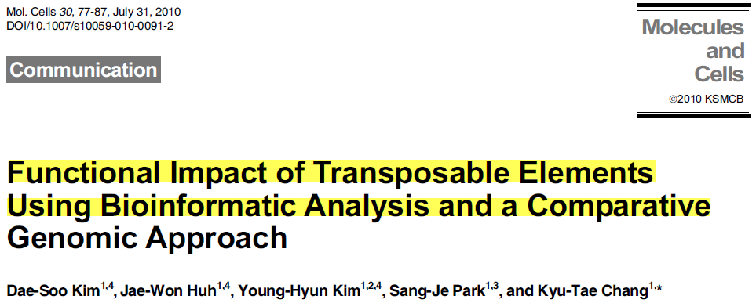
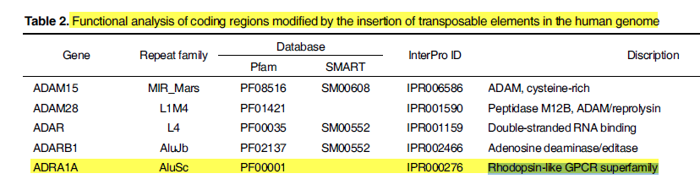

Slide 6
THE GARDEN STORY
WHAT WAS THE ACTUAL TEMPTATION?
WHAT WAS THE ADVERSARY TRYING TO ACHIEVE?

Slide 7
THE STORY

Slide 8
“And the Lord commanded the man, saying, Of every tree of the garden thou mayest freely eat: But of the tree of the knowledge of good and evil, thou shalt not eat of it: for in the day that thou eatest thereof thou shalt surely die (dying thou shalt die)”.
(Genesis 2:16,17 KJV)
“And the serpent said unto the woman, Ye shall not surely die: For God doth know that in the day ye eat thereof, your eyes will be opened, and ye shall be as gods, knowing good from evil.” (Genesis 3: 4,5 KJV)
ONE OF THE TWO IS LYING……BUT WHICH ONE?

Slide 9
What was the Adversary asking Eve to do?
Rely on her own sensory input as the ultimate reality instead of God’s word.
To doubt God had her best interest in mind when He forbade eating the fruit from Tree of Knowledge of Good and Evil (TKGE). Implied in the following questions:
Is God not the Creator of the whole world and this garden?
Has God been only loving and good in all His dealings with you and Adam?
Has any of the fruit from other Garden trees ever had any ill effects?

Slide 10
Questions Cont.:
Is it logical then, that a life-giving God would create a tree whose fruit had the power to cause your death and put it in Garden right next to the Tree of Life where you can’t miss it?
Given the fact that everything in God’s creation has been for your benefit, would it not be logical to assume that the fruit from the TKGE would also be beneficial--not harmful-- if eaten?
Would you like to see evidence supporting this assertion?
I am providing this as we speak as I have already partaken of the fruit—and, as can be readily seen, not only have I no untoward effects, I have actually entered a higher state of existence.

Slide 11
Questions cont.:
Since we are both created beings, if the fruit has given me greater intelligence (ability to verbally communicate), what wonderful things might it do for you? (Pantheism)
Anyway, If obedience is the purpose of this “test” would God, who created all life, use a harsh tactic that results in death?

Slide 12
WHAT HAD THE DEVIL CONVIENENTLY LEFT OUT OF THIS DISCUSSION?
HIMSELF

Slide 13
What was the Adversary’s goal?
Disbelief?
Believe a lie?
Disobedience?
Yes—but all three were a “means to an end”—not the goal itself!

Slide 14
NOTE: ADAM WAS NOT DECEIVED!
And Adam was not deceived, but the woman being deceived was in the transgression.
(1 Timothy 2:14 AKJV)
And it was not Adam who was deceived; it was the woman who was deceived and broke God's law.
(1 Timothy 2:14 GNB)
In order to be deceived, one must first disbelieve God and then believe a lie—Adam did neither.

Slide 15
What was the Deceiver’s goal?
For God does know that in the day you eat thereof, then your eyes shall be opened, and you shall be as gods, knowing good and evil.
And when the woman saw that the tree was good for food, and that it was pleasant to the eyes, and a tree to be desired to make one wise (to give insight, to teach), she took of the fruit thereof, and did eat, and gave also to her husband with her; and he did eat. (Genesis 3:5-6 AKJV)
All three players in this drama completely agree that “eating of the fruit” is key to what comes next.

Slide 16
“Wise”—to give insight, to teach, to have comprehension..
The only way that this could happen instantaneously (if it could at all) would be through a change in the information system of Eve--because apparently the snake (who had already eaten of the fruit) had developed vocal cords and the CNS circuitry to control them—and this could only happen via an addition to his information system.
The temptation’s final purpose then, was not just to deceive her about God’s character, it was to get Eve to agree to change her information system—for that is what apparently had happened to the snake.

Slide 17
Does sin have a physical basis? Or is it just a state of mind?
How is it transferred? Through heredity—MGE’s in genome. (Physical)
Why, as by one man sin entered into the world, and death by sin; and so death passed on all men, for that all have sinned:
(Romans 5:12 AKJV)
What are its consequences? The First Death (MGE’s) and the Second Death (MGE’s?)—(Physical)
For the wages of sin is death; but the gift of God is eternal life through Jesus Christ our Lord.
(Romans 6:23 AKJV)

Slide 18
Does sin have a physical basis? Cont.:
Is there something that can reverse the “death”? Yes, eating the fruit of the Tree of Life. (Physical)
And the LORD God said, Behold, the man is become as one of us, to know good and evil: and now, lest he put forth his hand, and take also of the tree of life, and eat, and live for ever:
(Genesis 3:22 AKJV)

Slide 19
HOW COULD MGE’s GET INTO ADAM AND EVE’S GENOME IN THE FIRST PLACE?
God and the Devil made an agreement that should the pair eat of the forbidden fruit, God would remove them from the Garden allowing the Devil to carry out his purposes.
The MGE’s were in the fruit of the TKGE.

Slide 20
Two Trees
Tree of Life
Tree of the Knowledge of Good and Evil
According to Genesis 3:22, something in the fruit is biologically active.
In Revelation 22:2, it states, “and the leaves of the tree were for the healing of the nations;” indicating biologically active ingredients in the leaves.
Could something biologically active also be present in this fruit as well??

Slide 21
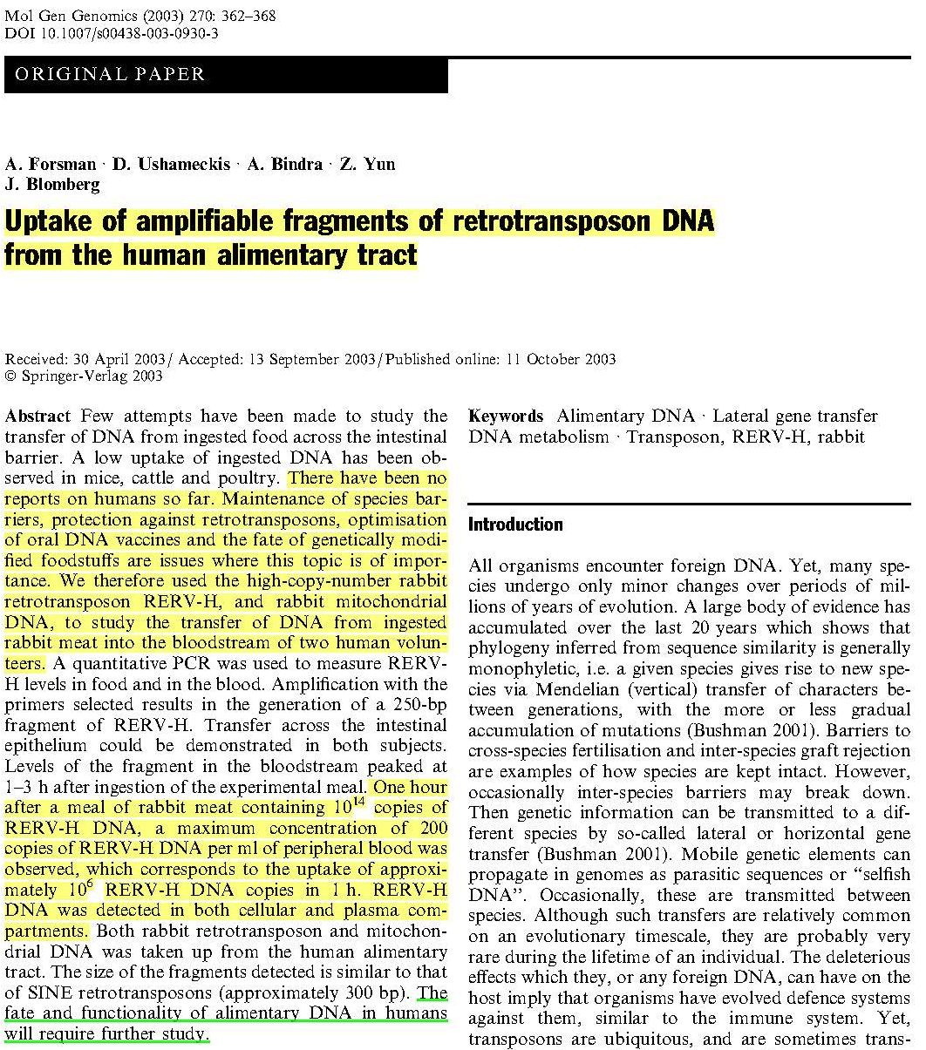
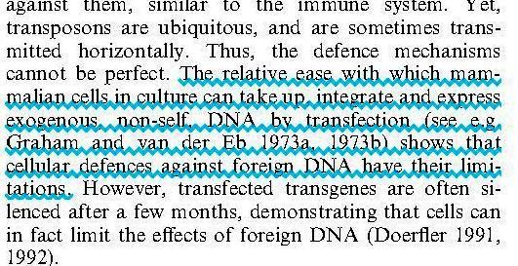

Slide 22
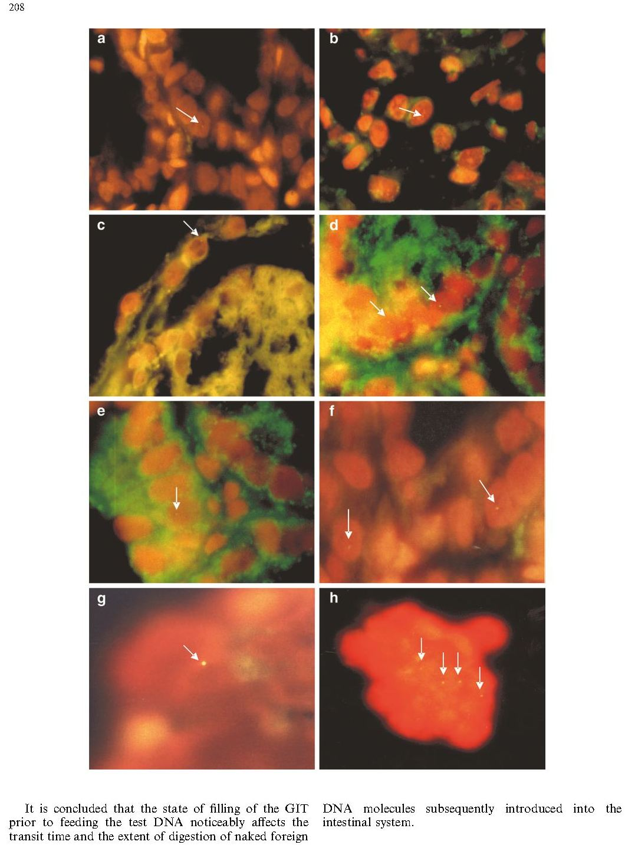
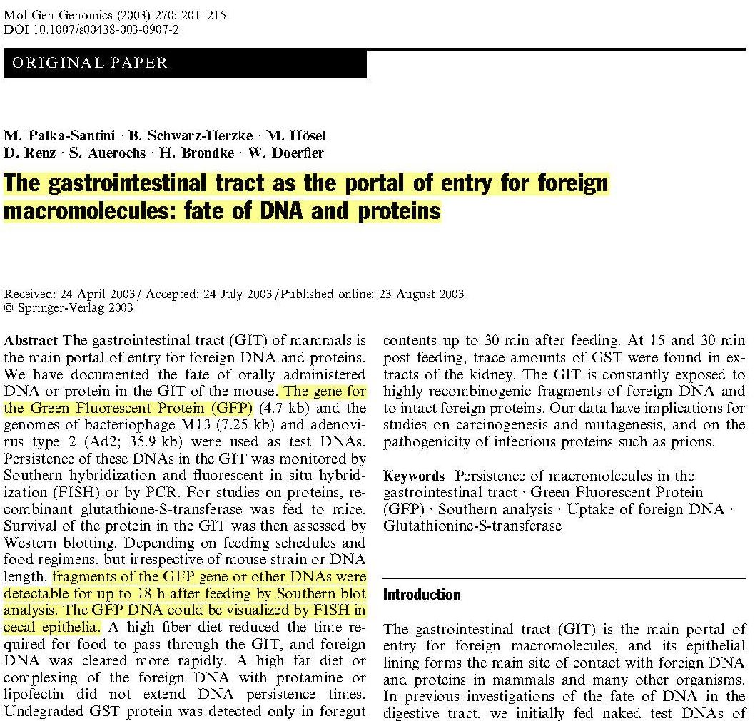

Slide 23
Interesting evidence which supports that MGE’s were fruit born, and not introduced later outside the Garden, can be found in what transpired soon after the pair ate the fruit:
And the eyes of them both were opened, and they knew that they were naked; and they sewed fig leaves together, and made themselves aprons. (This happened before the pair were confronted by God and still in the Garden.)
(Genesis 3:7 AKJV)
And the man said, The woman whom you gave to be with me, she gave me of the tree, and I did eat. (This occurred while still in the Garden)
(Genesis 3:12 AKJV)

Slide 24
THE THREE “CURSES”?

Slide 25
'ârar BDB Definition: 1) to curse
Hebrew 'arar means "to bind (with a spell), hem in with obstacles, render powerless to resist."

Slide 26
GOD RESPONDS TO THE SERPENT
And the LORD God said to the serpent, Because you have done this, you are cursed above all cattle, and above every beast of the field; on your belly shall you go, and dust shall you eat all the days of your life:
And I will put enmity between you and the woman, and between your seed and her seed; it shall bruise your head, and you shall bruise his heel.
(Genesis 3:14-15 AKJV)

Slide 27
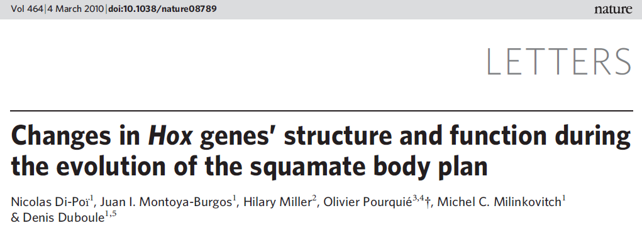
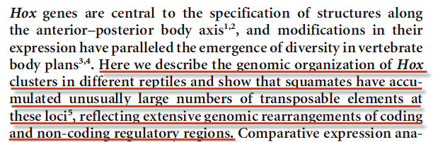
NATURE| Vol 464|4 March 2010

Slide 28
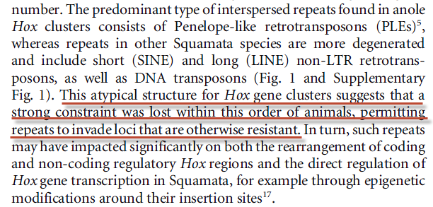
NATURE| Vol 464|4 March 2010

Slide 29
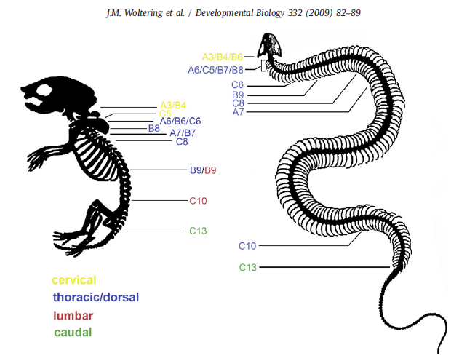

Slide 30
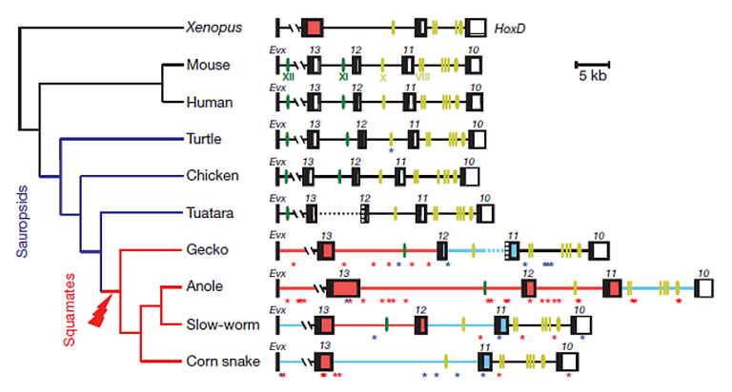
Transposable elements are indicated with asterisks of different colors (blue for DNA transposons; red for retrotransposons).
NATURE| Vol 464|4 March 2010

Slide 31
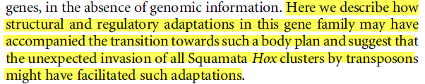
NATURE| Vol 464|4 March 2010

Slide 32
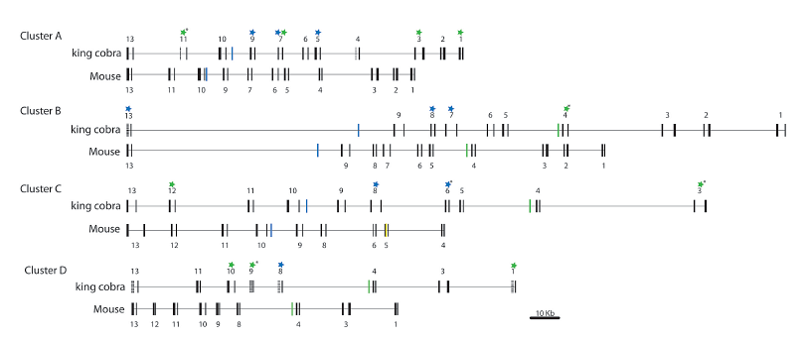
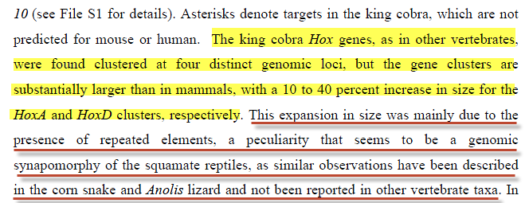
PNAS. December 17, 2013 vol. 110 no. 51

Slide 33
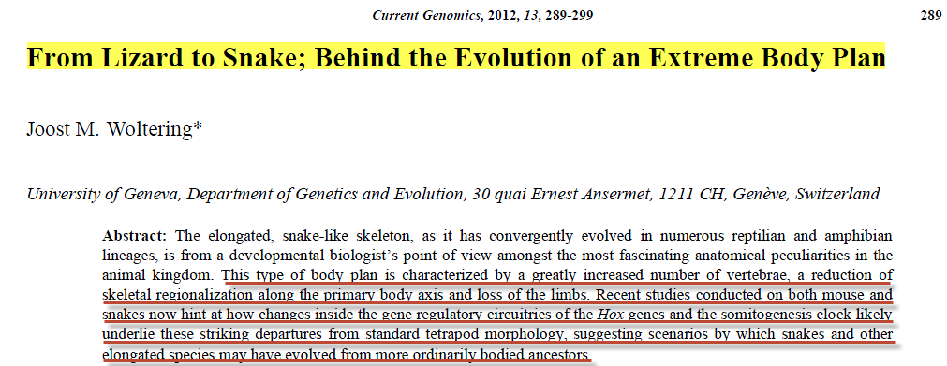
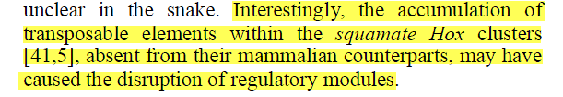

Slide 34
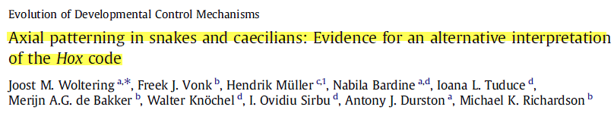
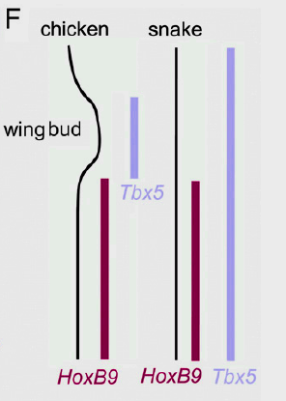
No limb buds are present in corn snakes however, and neither is any molecular trace of a discrete forelimb domain.
Developmental Biology 332 (2009) 82–89

Slide 35
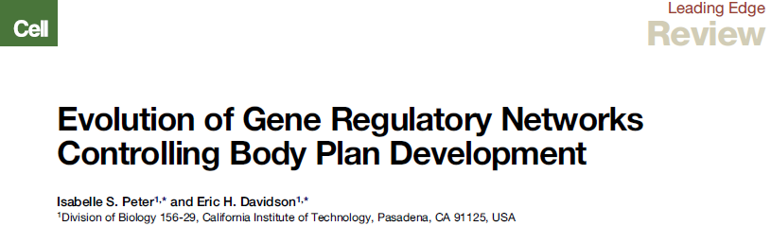
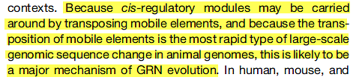

the Tbx5 gene, deeply embedded in the vertebrate heart formation GRN, turns out to be regulated differently during heart formation in reptiles than in birds and mammals,…(p 976)
Cell 144, March 18, 2011

Slide 36
Historical view of Genesis 3:15:
You and this woman will hate each other; your descendants and hers will always be enemies. One of hers will strike you on the head, and you will strike him on the heel." (Genesis 3:15 CEV)
The Adversary does not have any “descendants”, all of the “descendants” come from the woman and Adam (who is not even mentioned here…why?).
Genomic view:
And I will put enmity between thee and the woman, and between thy seed (Genetic Material) and her seed (Genetic Material); it shall bruise thy head, and thou shalt bruise his heel. (Gen 3:15 KJV)

Slide 37
G4690 - Strong’s Number - Greek
sperma H319 acharit - after part, end
sperma H1121 ben - son, grandson, child
sperma H1320 basar - flesh
sperma H2233 zera - seed, sowing, semen virile
sperma H5209 nin - offspring, posterity
sperma H5220 nekhed - progeny, posterity

Slide 38
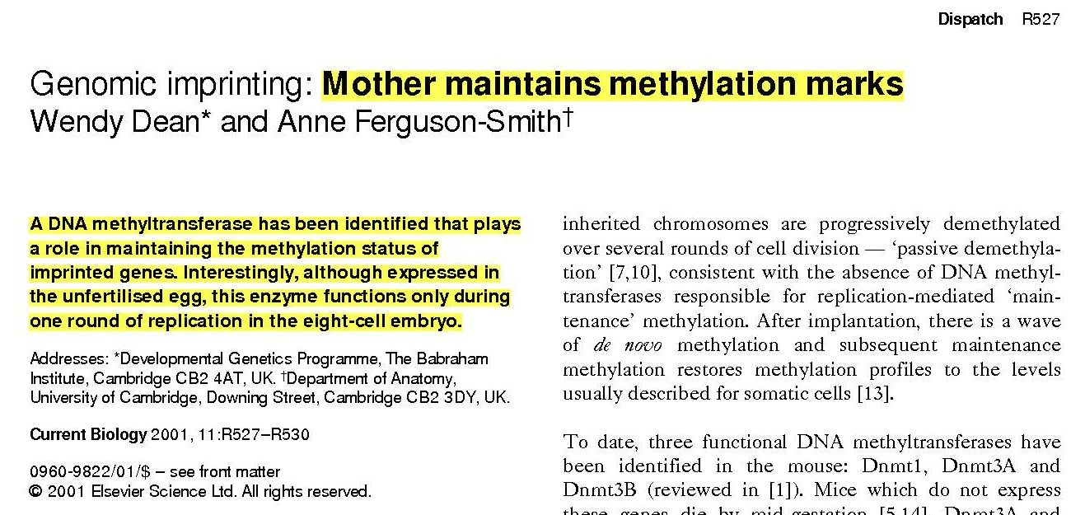

Slide 39
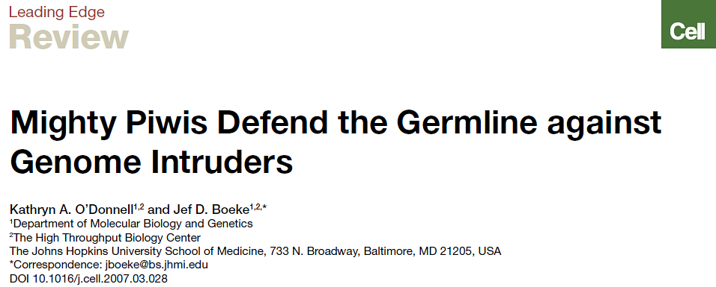
In recent years, Piwi proteins were recognized as having potential anti-mobile element activity.
Cell 129, April 6, 2007

Slide 40

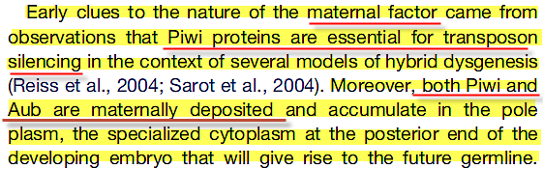
Cell 136, 656–668, February 20, 2009

Slide 41
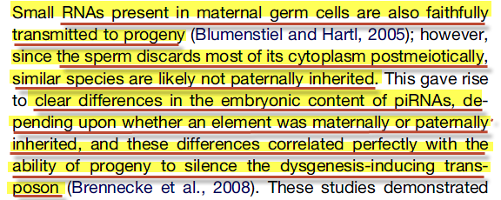
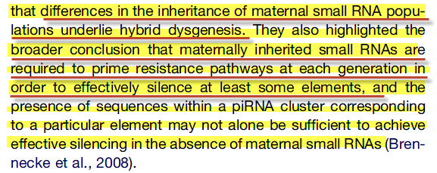
Small RNAs as Guardians of the Genome:
Cell 136, 656–668, February 20, 2009

Slide 42
Thank your Mother:
Defense of Genome Comes from Mother

Slide 43
GOD RESPONDS TO EVE
To the woman he said, I will greatly multiply your sorrow and your conception; in sorrow you shall bring forth children; and your desire shall be to your husband, and he shall rule over you.
(Genesis 3:16 AKJV)
To the woman he said, "I will greatly increase your pains in childbearing; with pain you will give birth to children. Your desire will be for your husband, and he will rule over you."
(Genesis 3:16 NIV)

Slide 44
Pregnancy and Birth

Slide 45
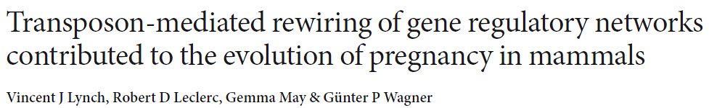
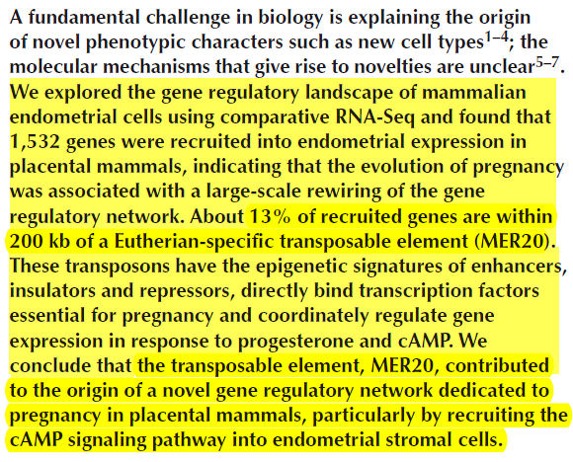
Nature Genetics 25 September 2011

Slide 46
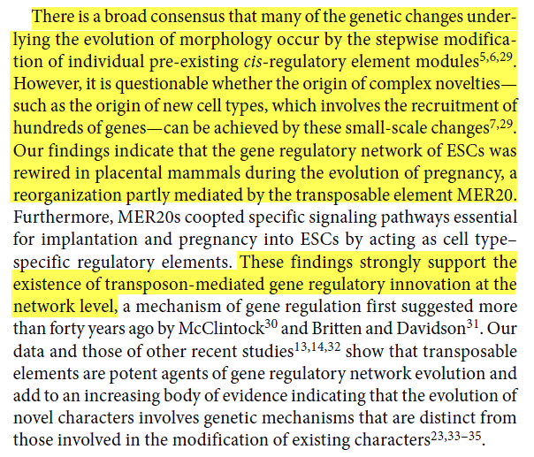
Nature Genetics 25 September 2011

Slide 47
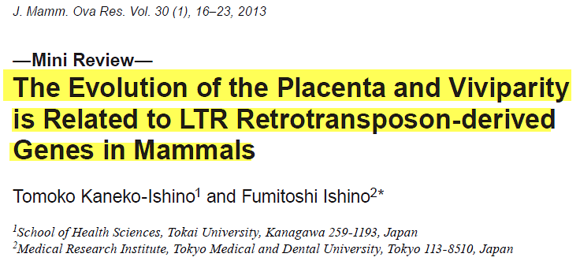
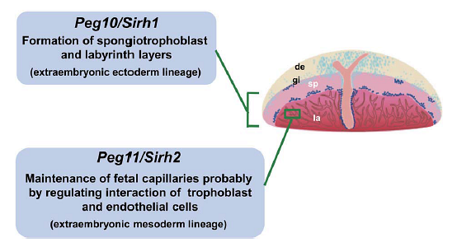
Two LTR Retrotransposon-derived Genes, PEG10 and PEG11/RTL1, Play an Essential Role in Mammalian Development

Slide 48
Review: Human Endogenous Retroviruses and the Placenta
Jun Sugimoto, PhD University of Missouri-Columbia, Department of Obstetrics, Gynecology and Women's Health, Division of Reproductive Endocrinology and Infertility, Columbia, Missouri, Danny J. Schust, MD
University of Missouri-Columbia, Department of Obstetrics, Gynecology and Women's Health, Division of Reproductive Endocrinology and Infertility, Columbia, Missouri
Up to 8% of the human genome is of retroviral origin. These stably integrated retroviral sequences that characterize the human endogenous retrovirus (HERV) arose from retroviral infections that occurred more than 25 million years ago. The host and the retrovirus have subsequently coevolved as retrovirally derived genetic material is propagated in a Mendelian fashion. Although most HERV sequences are silenced, several have been described that are functional. The effects of some HERV-derived products are linked to human disease; others appear essential to human organ function. The human placenta, unique in its active expression of retroviral sequences that are not expressed in other tissues, may hold the key to an improved understanding of the functional significance of HERVs. In this review, we discuss the contribution of retroelements, particularly HERVs, to placental function and dysfunction. We describe fusogenic and immunosuppressive HERV activities and emphasize epigenetic regulation of retroelement expression.
Key Words: Human endogenous retrovirus • placenta • immunosuppression • fusion • transposon.
This version was published on November 1, 2009

Slide 49


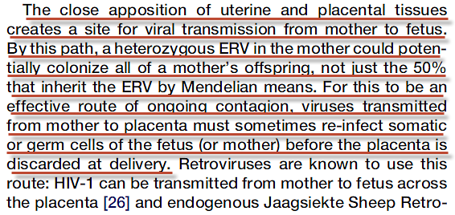
Current Biology 22, R609–R613, August 7, 2012

Slide 50
Bottom Line?
BIRTH = INFECTION

Slide 51
Behold, I was shaped in iniquity; and in sin did my mother conceive me. (Psalms 51:5 AKJV)
Surely I was sinful at birth, sinful from the time my mother conceived me. (Psalms 51:5 NIV)

Slide 52
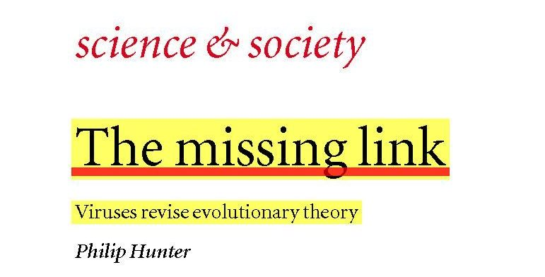
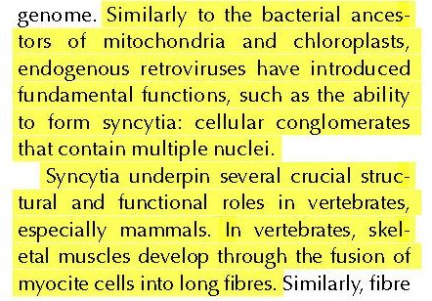

Slide 53
PAIN RECEPTORS ARE ALL G-COUPLED PROTEINS, AND THEY WERE ALL MODIFIED BY MGE’s.

Slide 54
GOD RESPONDS TO ADAM
And to Adam he said, Because you have listened to the voice of your wife, and have eaten of the tree, of which I commanded you, saying, You shall not eat of it: cursed is the ground for your sake; in sorrow shall you eat of it all the days of your life;
Thorns also and thistles shall it bring forth to you; and you shall eat the herb of the field;
In the sweat of your face shall you eat bread, till you return to the ground; for out of it were you taken: for dust you are, and to dust shall you return (first death).
(Genesis 3:17-19 AKJV)

Slide 55
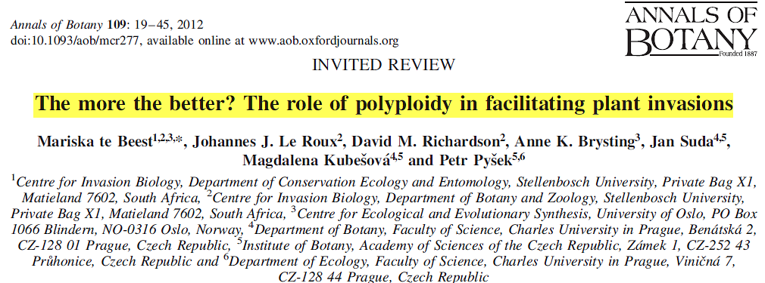
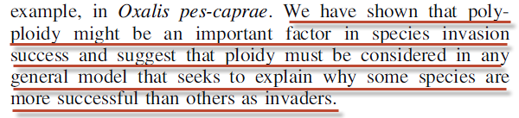

Slide 56
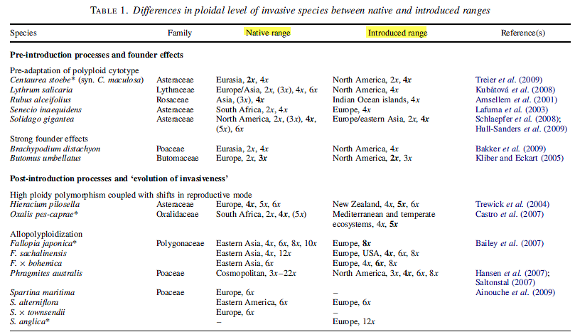
Annals of Botany 109: 19–45, 2012

Slide 57
“First death” already discussed in Lecture 3.

Slide 58
E.G. White
There was nothing poisonous in the fruit of the tree of knowledge itself, nothing that would cause death in partaking of it. The tree had been placed in the garden to test their loyalty to God. {ST, February 13, 1896 par. 6}

